Slide 1
COMP 3100
Week 6 - Wednesday

Slide 2
Last time
What did we talk about last time?
User interaction design
Swing

Slide 3
Questions?

Slide 4
Design Principles

Slide 5
SAC principles
Design principles favor certain characteristics to make a design better
SAC principles are three general interaction design principles
Simplicity
  Simple designs are better
  Lots of options are confusing for the user
  It's better to make commonly used options easy and require a little more work for unusual options
Accessibility
  Designs that can be used be more people are better
  Considerations: color blindness, things too small to see or interact with
Consistency
  Designs that present data in similar ways are better
  Example: use consistent navigation controls

Slide 6
CAP principles
CAP principles are focused on appearance
Contrast
  Designs that make different things obviously different are better
  Example: italics and bold
  Example: font size to distinguish headings from text
Alignment
  Designs that line up on a grid are better
  Indentation is useful
Proximity
  Designs that group related things together are better

Slide 7
FeVER principles
FeVER principles are about behavior
Feedback
  Designs that acknowledge user actions are better
  Otherwise, how do you know if what you're doing has an effect?
Visibility
  Designs that display their state and available operations are better
  Are we in Arm Bomb or Disarm Bomb mode?
Error Prevention and Recovery
  Designs that prevent user errors and allow error recovery are better
  Prevention example: disable buttons that shouldn't be pressed
  Recovery example: allow undo or ask "Are you sure?" before doing something dangerous

Slide 8
Visual Design Tips

Slide 9
Color

Slide 10
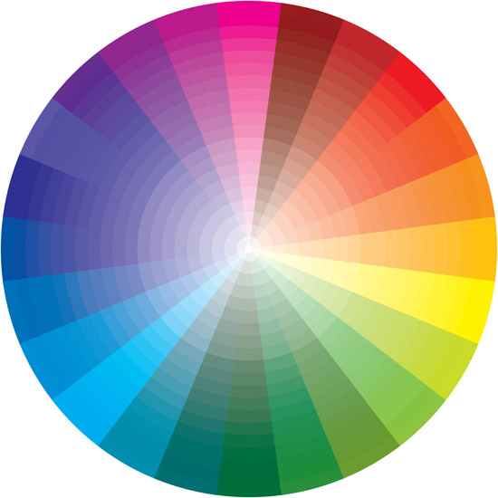
Color terminology
Artists divide colors into
  Primary: red, blue, yellow
  Secondary: mixes of primaries, orange, green, and purple
  Tertiary: combinations of primaries and secondaries
Complementary colors are across from each other on the color wheel, with strong contrast
Analogous colors are next to each other on the color wheel

Slide 11
Colors and psychological impact
Warm colors like red, yellow, and orange are on one side of the fence
  Red has associations with strong archetypes, like hatred, passion, and fire
  Yellow is tied to happiness and sunshine
Cool colors like green, blue, and purple are on the other
  Blue is cold and serene and trustworthy
  Green is associated with nature, the environment, healing, and money
  Purple is connected to royalty and femininity
Neutral colors like gray and brown do not evoke much emotion
  Black can run the range from authority to death to mystery to elegance
  White can show purity, innocence, cleanliness, winter
Colors evoke feelings in people, but there is so much variation

Slide 12

Backgrounds
A white background is the standard for readability
Black backgrounds are often used to give a more exciting, youth-oriented, or "cool" feel
Background colors are important since a single color can look different on different backgrounds

Slide 13

Identity
Corporate branding is heavily tied to recognizable colors
T-Mobile has even sued other companies for using magenta (unsuccessfully, it seems)

Slide 14
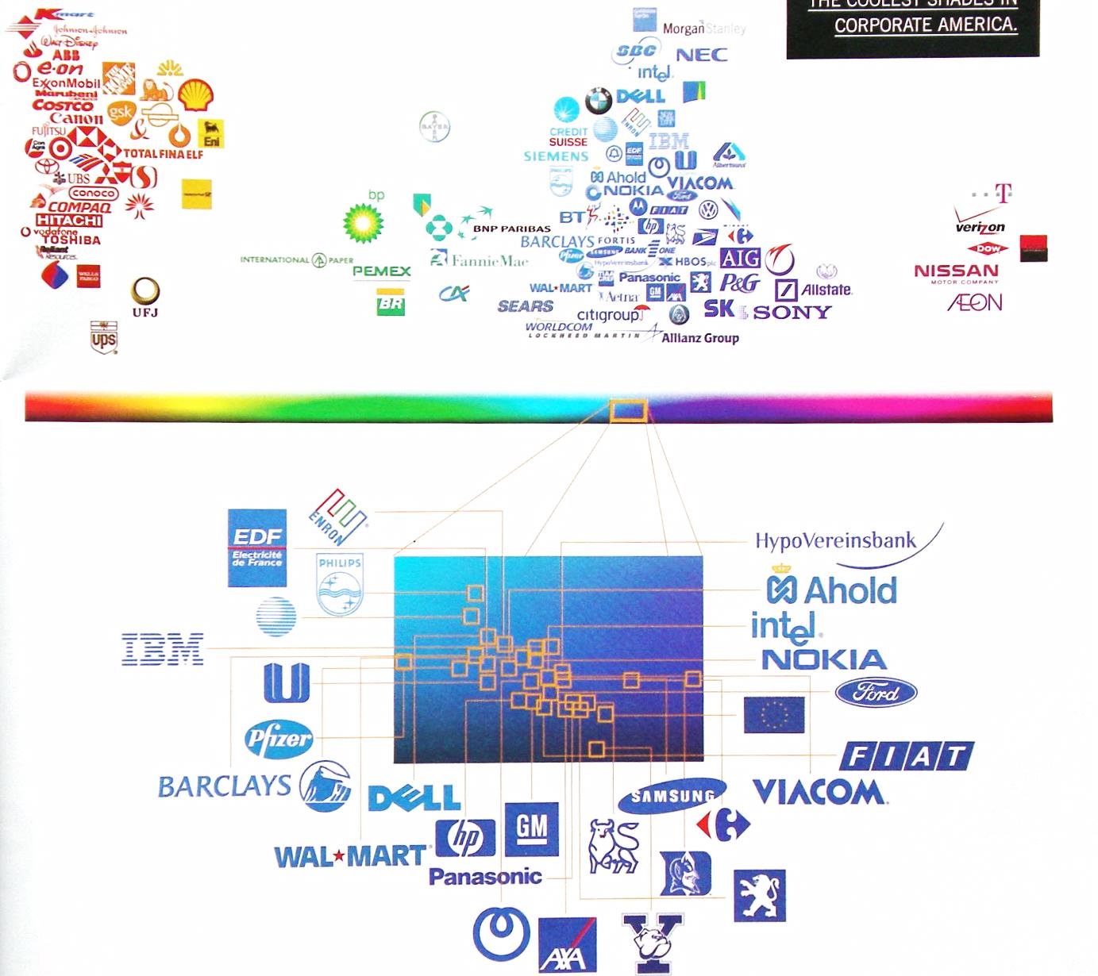
Graphic from Wired magazine 2003

Slide 15
Color tools
Google Lighthouse can check a website for contrast and other issues
  It's a tool built into Chrome
Toptal is a website that lets you see what webpages look like for people with certain kinds of color blindness
  https://www.toptal.com/designers/colorfilter

Slide 16
Typefaces

Slide 17
Two major classes of fonts
Serif fonts have little pointy bits
F
Sans serif fonts do not
F

Slide 18
Picking a font
Make sure it is readable wherever it will display (books might be different from on screen)
Read your content out loud in the font you pick to test readability
Consider what audience you're trying to appeal to
What is the setting where your text will appear?
The process is subjective; there may not be a solution that pleases everyone

Slide 19
Typography for readability
Sans serif is usually considered more readable on screens
Avoid ALL CAPS
For headings, down style (capitalizing only the first word and proper nouns) is more readable than up style (capitalizing every major word)

Slide 20
Pairing fonts
Using lots of fonts is amateurish and looks like a ransom note
Using a single font is reasonable, especially for a webpage
Some designers prefer to pair fonts, using two distinct fonts, often one for headings and the other for text
  An alternative is to use two very different weights of the same font
The fonts should be different enough that they are not confused
  Ideally from different families
Serif for headings and sans serif for body is a good stand by
Sometimes the headings will be images of text rather than text

Slide 21
Other font guidelines
Contrast is key
  Easy with black text on white background or vice versa
  If you are using colored fonts or backgrounds, how much contrast is there if you were to change to grayscale?
Size
  Don't go too small!
  10pt or 12px is the smallest your fonts should be
Hierarchy
  Use different fonts or weights or styles for title, heading, and body text
  Be consistent!
Negative space is important
  Lets the eye rest
  Keeps the content from running together

Slide 22
More design principles
Alignment and proximity
Balance
Consistency and repetition
Contrast and whitespace
Gestalt
Golden ratios

Slide 23
Alignment and proximity
All the images and text in your layout should follow some plan for alignment
  Horizontal
  Vertical
  Edges aligned
  Everything centered
  "Visual" alignment
Unaligned items usually look sloppy
It's possible to break alignment for a dramatic effect
Items being close together suggests that they relate to each other

Slide 24
Balance
Symmetrical
Evenly distribute text and graphics
Symmetrical balance divides things down the middle
Asymmetrical balance leans to one side to create emphasis or interest
  Visual center is not always the center of the page
In radial balance, elements radiate from the middle
The rule of thirds suggests that a design can be made interesting by dividing the space into thirds such that important elements fall into only one of the three
Asymmetrical
Radial

Slide 25
Consistency and repetition
Repetition is often a good thing in design
Use the same styles and fonts consistently for top level headings, body text, quotes, etc.
Use consistent layout for navigation bars and layout
Page numbers or copyright notices should be in the same place on each page
Repetition is comforting to readers
  They will often complain if there is any change, even if the new design is an improvement

Slide 26

Gestalt
Gestalt is the idea that the whole is different than the sum of its parts
Each individual part of a design can seem good on its own, but it might not fit together right
Think about figure and ground
Things that are incomplete are perceived as whole
Many of the guidelines about grouping similar items together or making things with similar functions look similar come from gestalt psychology

Slide 27
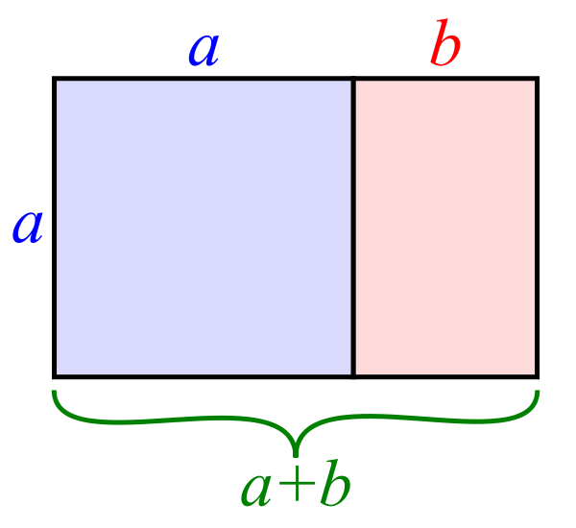
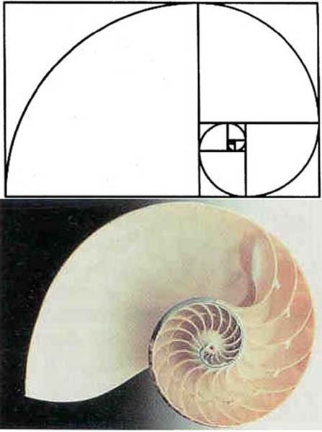
Golden ratio
The golden ratio (or mean) is φ (phi), approximately 1.61803398874989 and even more approximately 5:3
  This value occurs in the closed-form solution of Fibonacci
This ratio occurs in nature and is considered to look pleasing in art and design
It comes from the relationship a + b:a as a:b
This ratio is a good guideline for dividing up columns or organizing other layout

Slide 28
Software Engineering Design

Slide 29
Software engineering design
Software engineering design is designing programs, sub-systems, and their constituent parts
Product design and interface design specifies the external features of a product
Engineering design specifies the internal features
  Making it work
When designing, it can be useful to make many different models showing different views of the system
  Class diagrams breaking the system into its parts
  State diagrams showing the states it can be in
  Diagrams showing hardware and software interactions

Slide 30
Preventing design defects
A number of approaches can be used to avoid design defects
Design principles: Using a list of good principles helps you make good choices
Design notations: Using good notations (often UML diagrams) helps designs be complete and consistent
Design processes: Using established processes for designs helps avoid mistakes
Design patterns: Using patterns, models designed to be imitated, reuses solutions that have worked in the past (and make design easier)

Slide 31
Active review
The previous slide was about preventing design defects
To detect and remove design defects, an effective technique is active review
In an active review, experts answer questions about parts of the design
Active reviews have three phases:
  Preparation: Designers choose parts of the design they aren't happy with, choose experts to examine each part, and prepare questions for the experts
  Performance: Reviewers get the design and answer the questions
  Complete: Designers read the responses and update their design

Slide 32
Design principles
As with interface design, there are many software design principles that can help us evaluate the quality of a design
Some important design principles are:
  Simplicity
  Small modules
  Information hiding
  Minimize module coupling
  Maximize module cohesion
In this context, module means any meaningful program unit
  For OOP, classes or methods are usually considered modules
  The definition is intentionally vague to cover many different languages
  It does not mean Java modules (an organization level above packages in Java 9+)

Slide 33
Simplicity
As with interface design, simpler designs are better
What is simplicity?
  Fewer lines of code
  Fewer control structures
  Fewer connections between different parts
  Fewer computations with different kinds of objects
A good rule of thumb is which design is easiest to understand
Simplicity is a good goal, but some important algorithms in computer science are necessarily complex
Everything should be made as simple as possible, but not simpler.
-Attributed to Albert Einstein, who probably did not say it quite like that

Slide 34
Small modules
Designs with small modules are better
Smaller modules are easier to read, to write, to understand, and to test
Miscellaneous guidelines:
  Classes should have no more than a dozen operations (methods)
  Classes should be no more than 500 lines long
  Operations should be no more than 50 lines long
  I have heard that you should be able to cover a method with your hand
Of course, it is often impossible to follow these guidelines

Slide 35
Information hiding
Each module should shield the internal details of its operation from other modules
Declare variables with the smallest scope possible
Use private (and protected) keywords in OOP languages to hide data (and even methods) from outside classes
Advantages of information hiding:
  Modules that hide their internals can change them without affecting other things
  Modules that hide information are easier to understand, test, and reuse because they stand on their own
  Modules that hide information are more secure and less likely to be affected by outside errors
This is why we use mutators and accessors instead of making members public

Slide 36
Minimize module coupling
Module coupling is the amount of connectivity between two modules
Modules can be coupled in the following ways:
  One class is an ancestor of another class
  One class has a member whose type is another class
  One class has an operation (method) parameter whose type is another class
  One operation calls an operation on another class
If there two modules have many of these couplings, we say that they are strongly coupled or tightly coupled
When modules are strongly coupled, it's hard to use them independently and hard to change one without causing problems in the other
Try to write classes to be as general as possible instead of tied to a specific problem or set of classes
Using interfaces helps

Slide 37
Maximize module cohesion
Module cohesion is how much the stuff in the module is related to the other stuff in the module
We want everything in a class to be closely related
It's best if a class keeps the smallest amount of information possible about other classes
More module cohesion usually leads to looser module coupling
Sometimes a module being hard to name suggests that its data or operations are not cohesive

Slide 38
Design process
Design Problem
Analyze Design Problem
The design process is a microcosm of the larger software development process
The steps are analyzing the problem, proposing solutions (and looking up existing solutions to similar problems), and evaluating the solutions (perhaps combining different solutions) until a design is selected
Generate and Improve Candidate Designs
Evaluate Candidate Designs
Select Design
Inadequate
Adequate
Design Specification
Finalize Design

Slide 39
Architectural design
Architectural design is specifying a program's major components
Architectural design is often modeled with a box-and-line diagram (also called a block diagram)
  Components are boxes
  Relationships or interactions between them are lines
  Unlike UML diagrams, box-and-line diagrams have no standards
  Draw them in a way that communicates your design

Slide 40
Architectural styles
Architectural styles are patterns that can be followed for architectures
  Model-view-controller
  Layered architecture
  Repository architecture
  Client-server architecture
  Pipe and filter architecture
Architectural styles are the high-level analog of design patterns
These styles can be used for parts of your design or combined into hybrid styles

Slide 41
Model-View-Controller
The Model-View-Controller (MVC) style fits many kinds of web or GUI interactions
The model contains the data that is being represented, often in a database
The view is how the data is displayed
The controller is code that updates the model and selects which view to use
The Java Swing GUI system is built around MVC
Good: greater independence between data and how it's represented
Bad: additional complexity for simple models

Slide 42
Layered style
Organize the system into layers
Each layer provides services to layers above it, with the lowest layer being the most fundamental operations
Layered styles work well when adding functionality on top of existing systems
Good: entire layers can be replaced as long as the interfaces are the same
Bad: it's hard to cleanly separate layers, and performance sometimes suffers

Slide 43
Repository style
If many components share a lot of data, a repository style might be appropriate
Components interact by updating the repository
This pattern is ideal when there is a lot of data stored for a long time
Good: components can be independent
Bad: the repository is a single point of failure

Slide 44
Client-server architecture
Client-Server styles are used for distributed systems
Each server provides a separate service, and clients access those services
Good: work is distributed, and clients can access just what they need
Bad: each service is a single point of failure, and performance might be unpredictable

Slide 45
Pipe and filter style
In the pipe and filter style, data is passed from one component to the next
Each component transforms input into output
Good: easy to understand, matches business applications, and allows for component reuse
Bad: each component has to agree on formatting with its inputs and outputs

Slide 46
Performance goals
Non-functional requirements usually relate to properties of the whole system
They must be planned for at the architectural level
Strategies for architecture designers meeting performance requirements:
  Use budgets: Each component is assigned a limit on time, space, or energy so that everything stays within the overall limit
  Choose appropriate styles: Layered architectures with a lot of layers can be slow
  Modify styles: Basic styles can be changed a little, for example, allowing a low-level layer to talk directly to a high-level one
  Emphasize simplicity: Simple versions of components might be faster and use less memory than full-featured ones
  Minimize synchronous interactions: Synchronous interactions are ones where components have to wait for answers from other components

Slide 47
Reliability goals
Reliability is the probability that a product will behave as it should under normal conditions for a given period of time
Like performance, it must be planned for at the architectural level
Strategies for architecture designers meeting reliability requirements:
  Choose appropriate styles: For example, client-server is very reliable, as long as the server is reliable
  Modify styles: A client server model could add redundant servers
  Control component interactions: Interactions between components should only happen through explicit interfaces
  Handle exceptions: Plan how exceptions will be handled at the architectural level so that it's clear what parts of the system are responsible for recovering from which errors
  Monitor system health: Build in a component to check to see if other components have failed

Slide 48
Quiz

Slide 49
Upcoming

Slide 50
Next time…
Detailed design
Design patterns

Slide 51
Reminders
Keep reading Chapter 7: Software Engineering Design for Monday
Keep working on the draft of Project 2
  Due Friday of next week

